Slide 1
SC1015
Mini-Project
Group 6
Rachel Lim Lin (U2321996E)
Jamie Gonzales Esguerra (U2310378B)
Cheng Hui Wen (U2322123G)

Slide 2
Table of contents
01
02
03
04
Problem Definition
Data Analysis
Machine Learning
Outcome and Insight

Slide 3

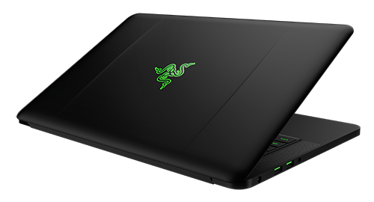
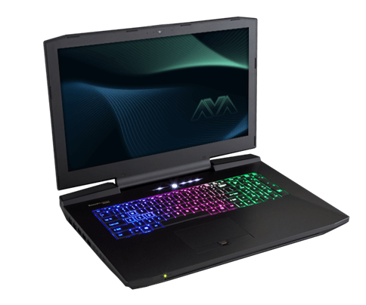
Introduction
Target : Companies
Pricing strategy

Slide 4
01
Problem Definition

Slide 5
What attributes affect the laptop’s prices the most and if we can predict the price of a laptop given those attributes?

Slide 6
02
Data Analysis

Slide 7
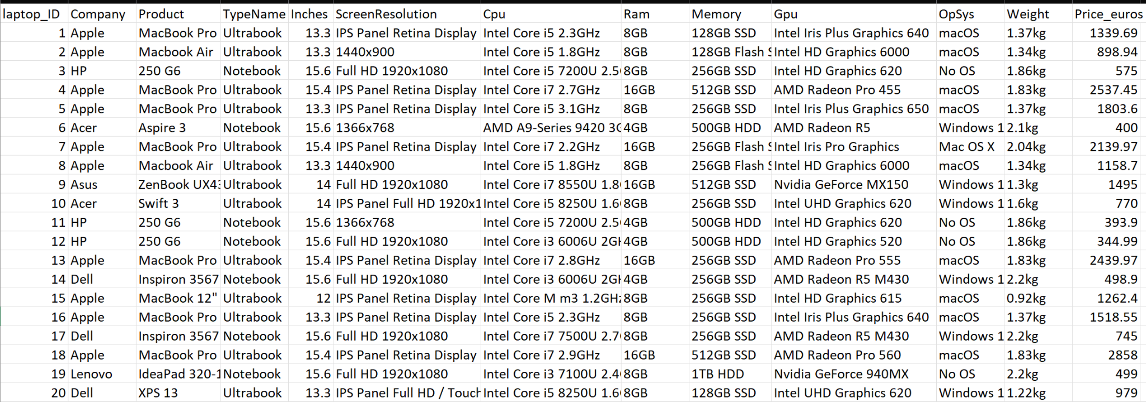
Laptop Price Dataset

Slide 8
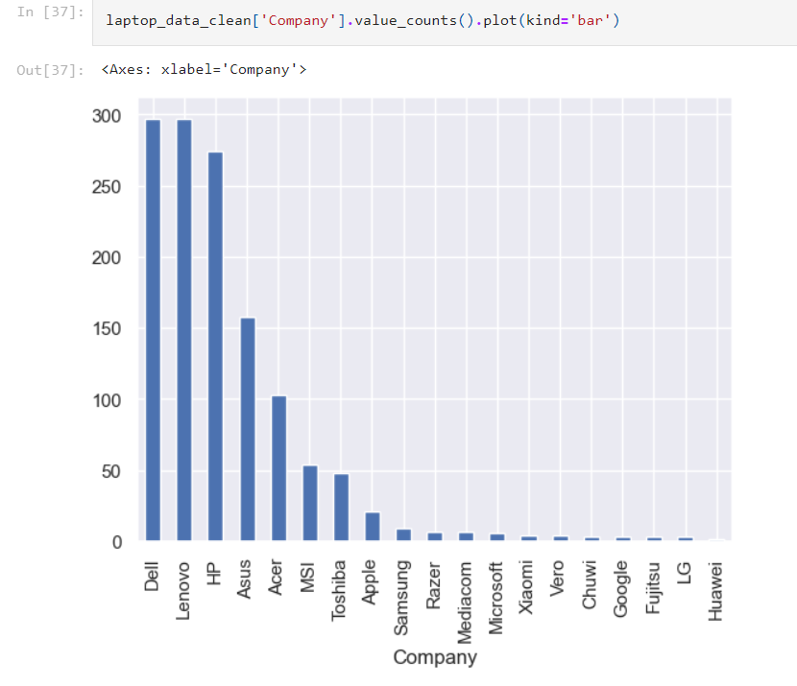
Laptop Price Dataset

Slide 9
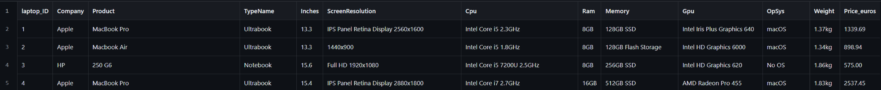
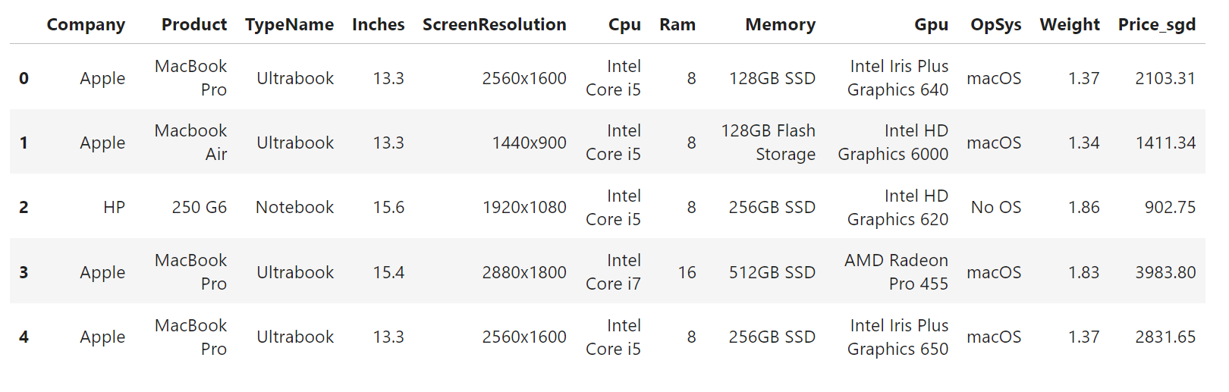
Data Cleaning

Slide 10
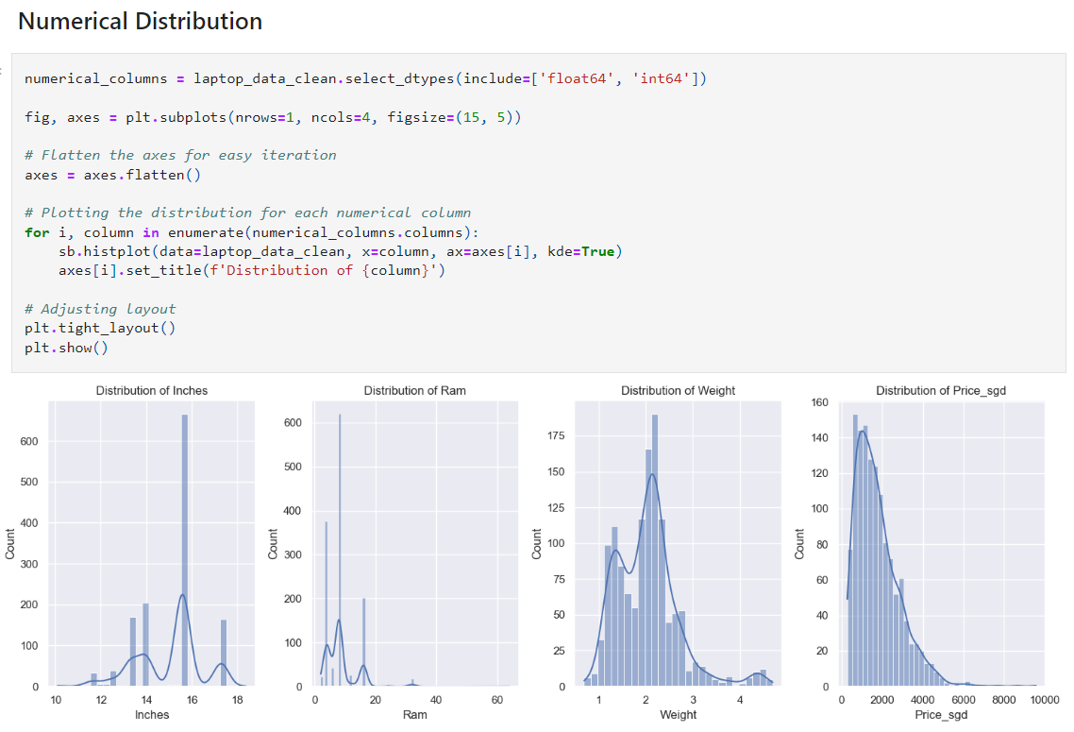

Slide 11
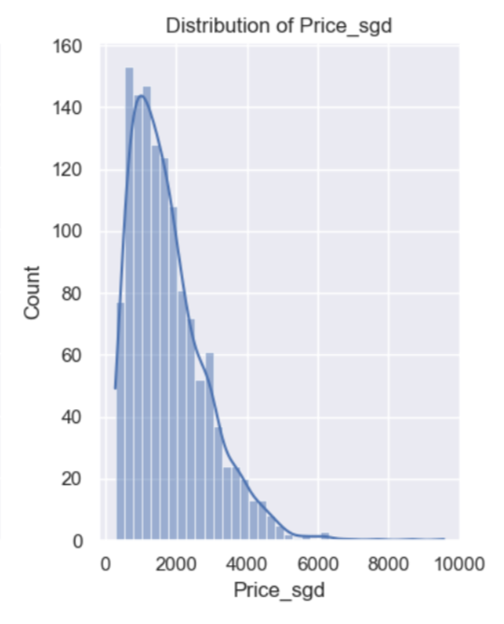
About $1000

Slide 12
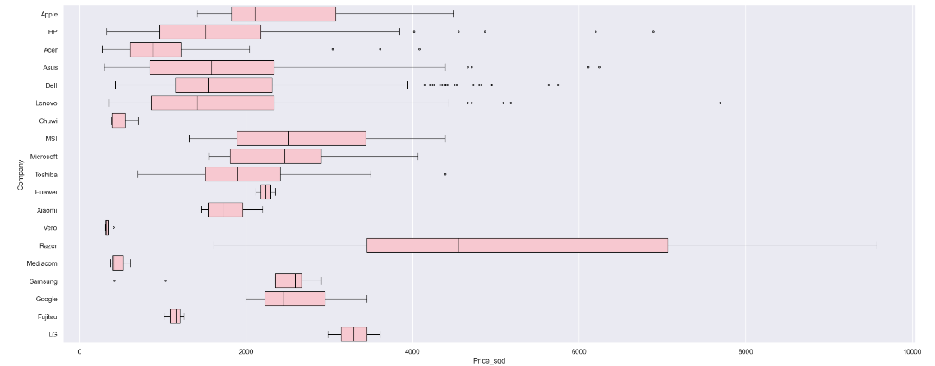
Analysing Price based on Companies
Razer (highest median)

Slide 13
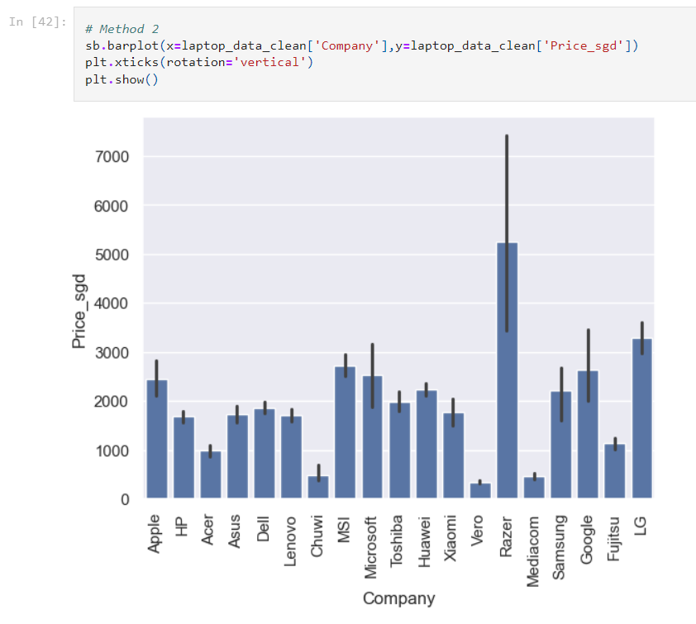

Slide 14
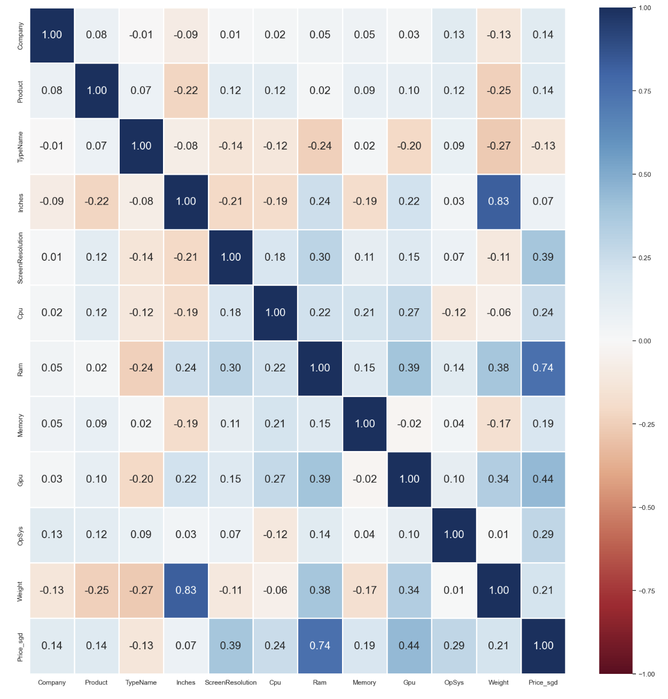
Correlation Matrix
Correlation value from highest to lowest (first 4 attributes):
Ram: 0.74
GPU: 0.44
Screen resolution: 0.39
Operating system: 0.29

Slide 15
03
Machine Learning

Slide 16
Machine learning techniques
Linear Regression
Neural Network
Random Forest Regression
KNN Regression

Slide 17
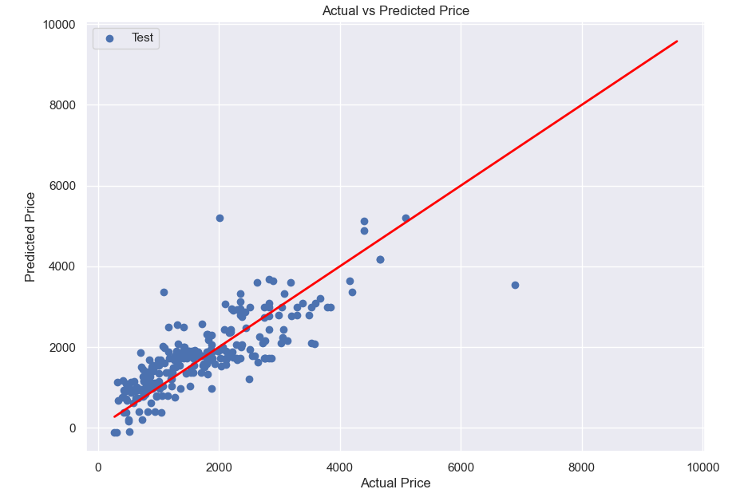
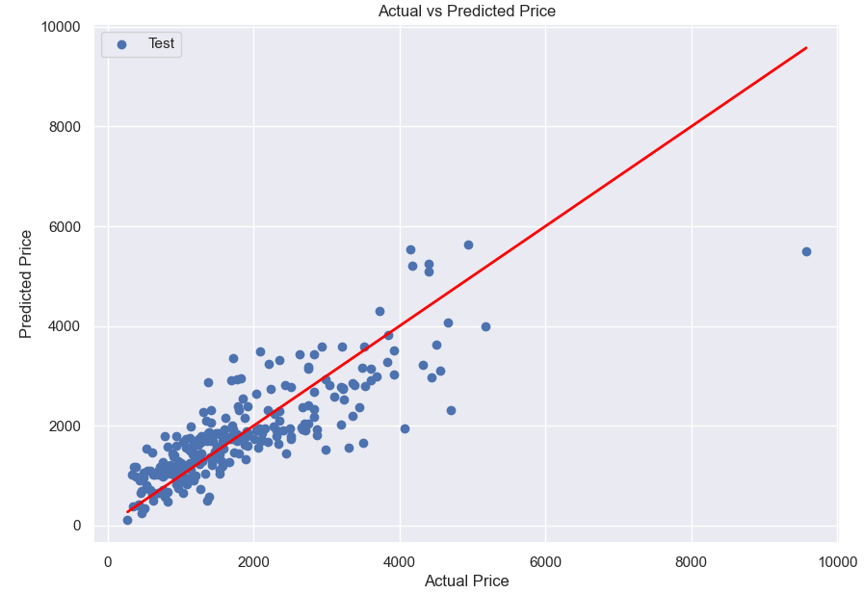
Linear regression
All attributes
4 attributes
BETTER
MSE = 3363732.39
Actual = 2009.74
Predicted = 2372.57
MSE = 423440.00
Actual = 1099.77
Predicted = 1001.66

Slide 18
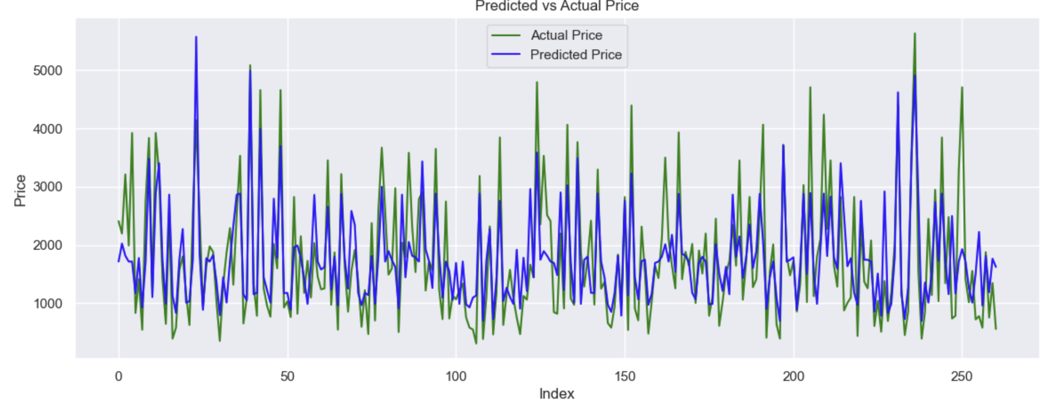
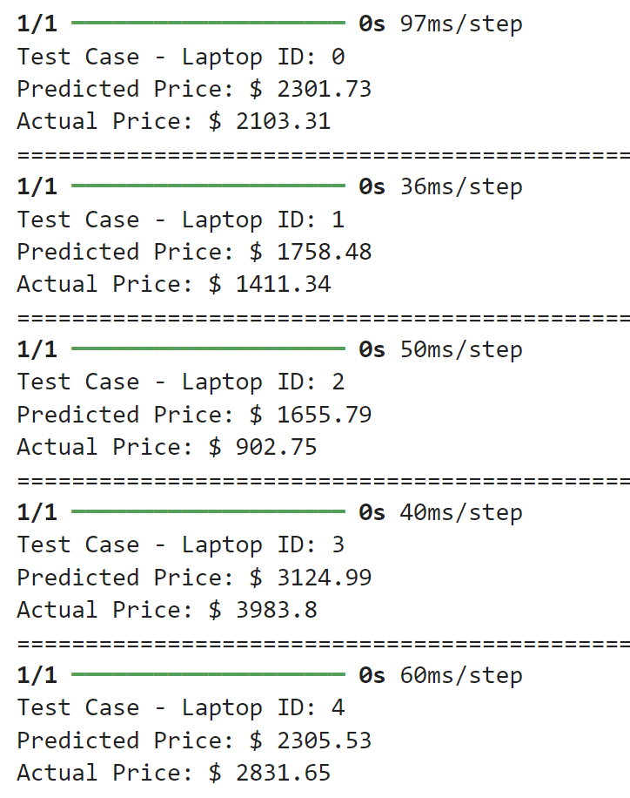
Neural Network - Keras

Slide 19
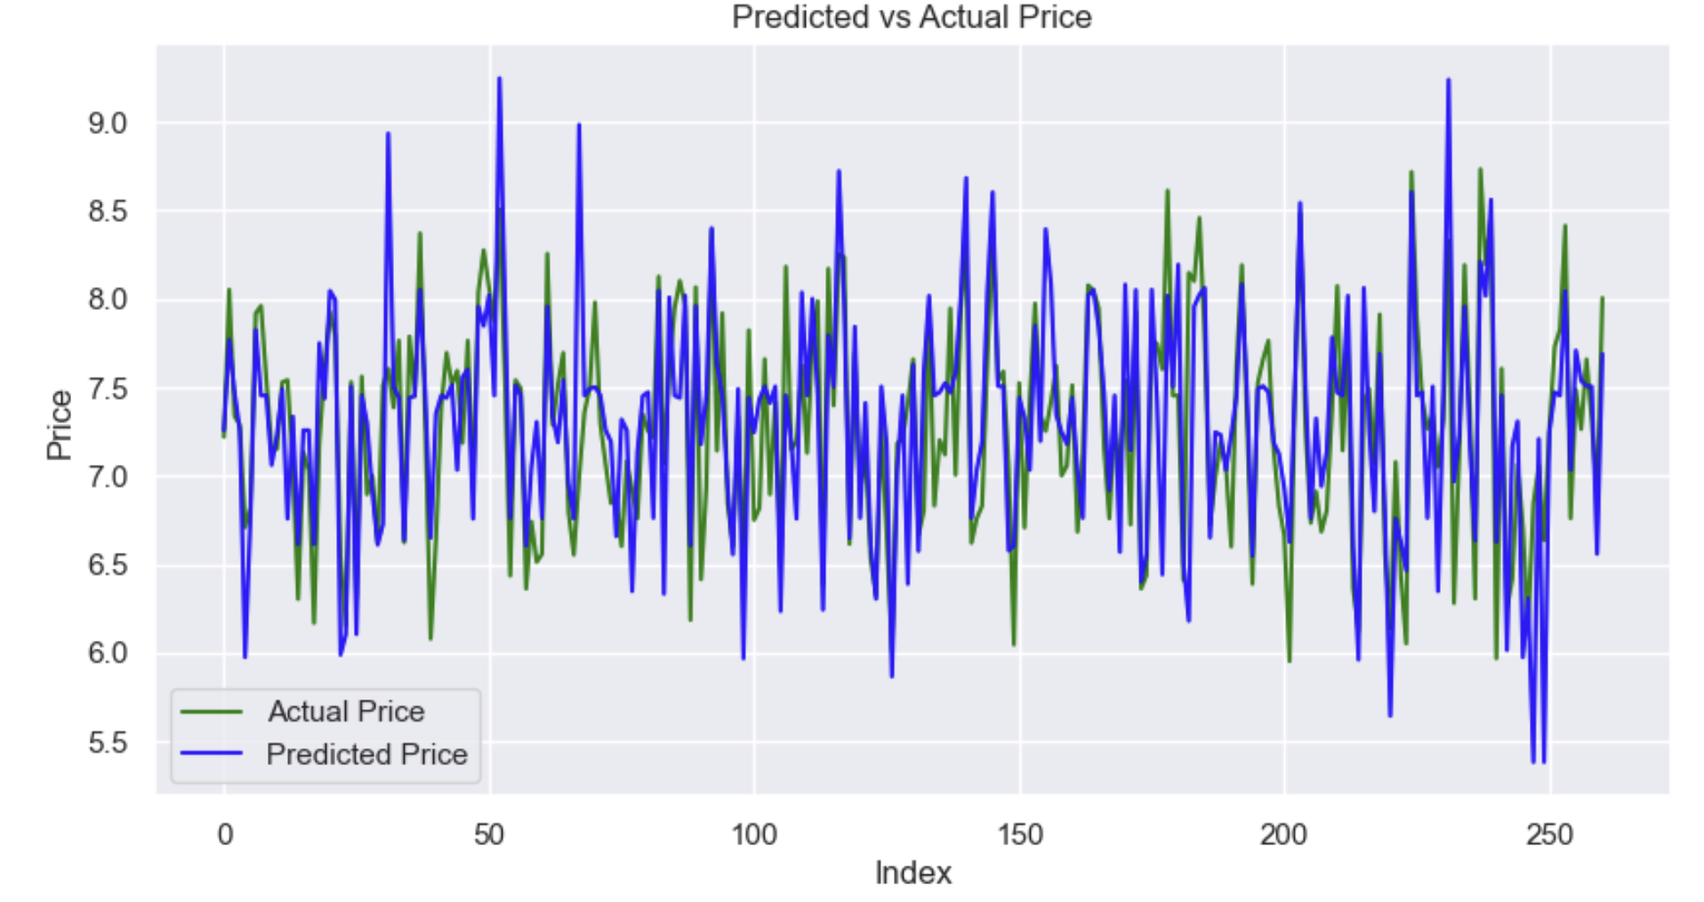
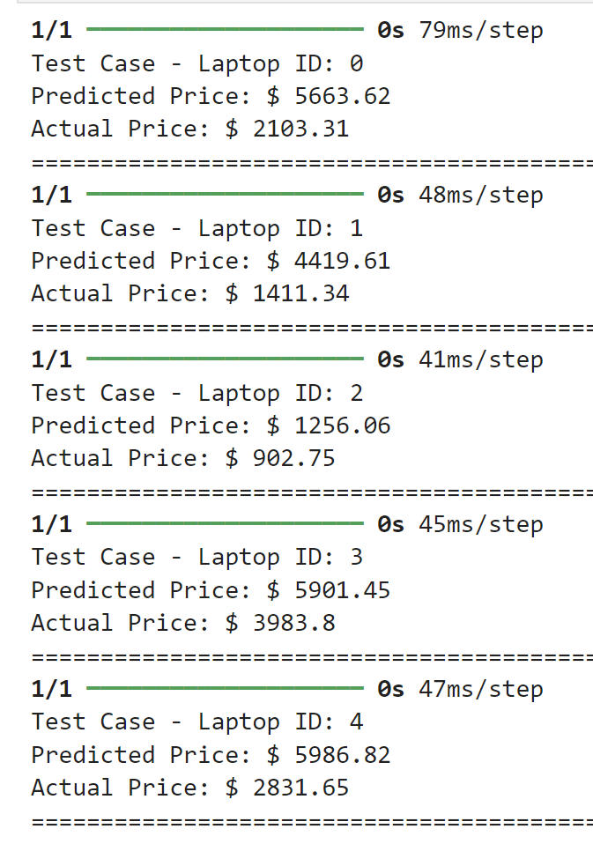
Neural Network - Keras

Slide 20
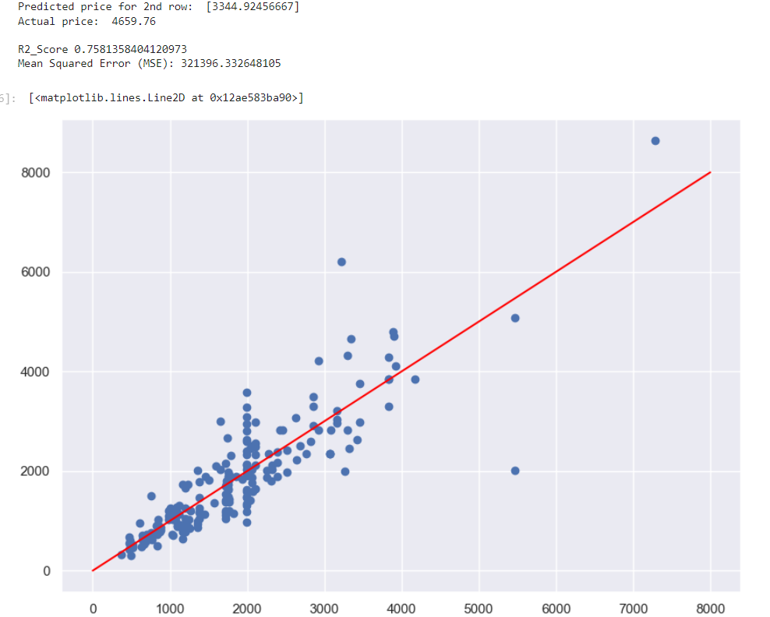
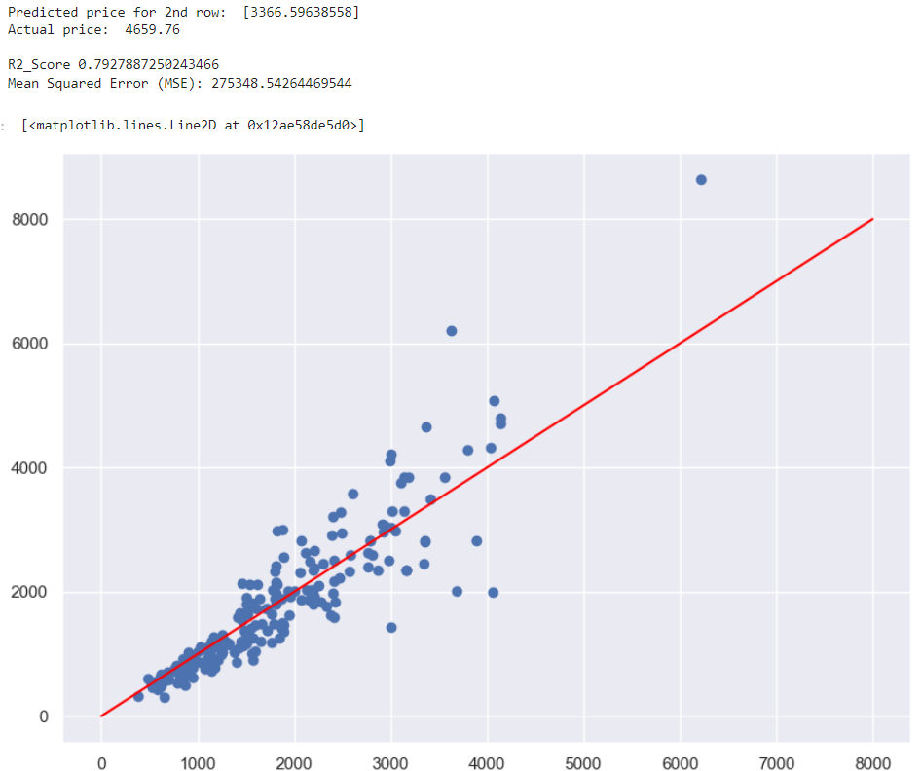
Random Forest Regression
4 attributes
All attributes
BETTER
MSE = 321396.33
Actual = 4659.76
Predicted = 3344.92
MSE = 275348.54
Actual = 4659.76
Predicted = 3366.60

Slide 21
Random Forest regression
Linear regression
vs
BETTER
MSE = 275348.54
Actual = 4659.76
Predicted = 3366.60
MSE = 3363732.39
Actual = 2009.74
Predicted = 2372.57

Slide 22
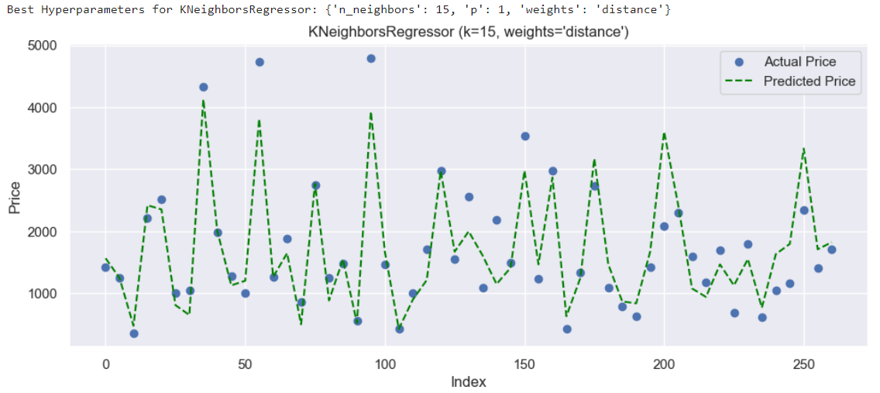
K Nearest Neighbour (KNN) Regression
KNN Regressor for all features:
MSE: 222663.00383073647
Predicted price: $2439.69
KNN Regressor for 4 features:
MSE: 242789.2479072067
Predicted price: $2243.72

Slide 23
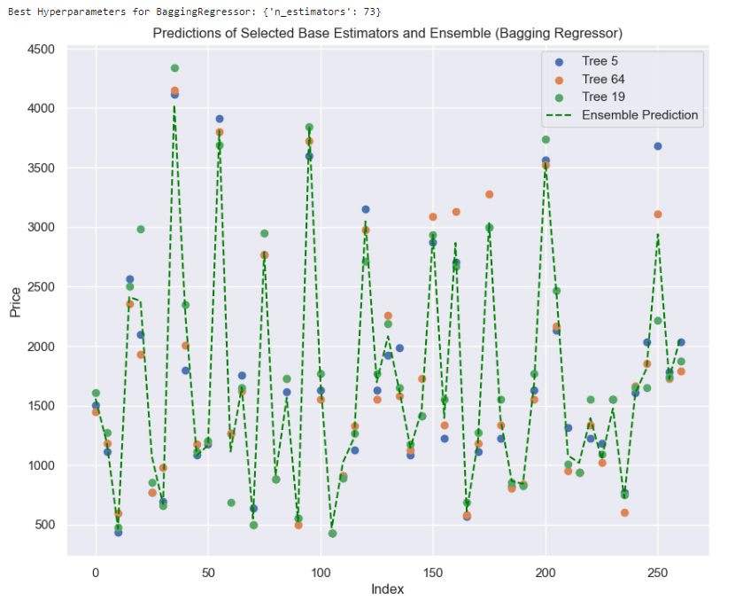
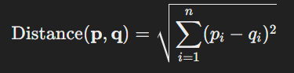
K Nearest Neighbour (KNN) Regression
Bagging Ensemble for 4 features :
MSE: 219952.71709183286
Predicted price (Bagging): $2305.43
Bagging Ensemble for all features:
MSE: 198118.52183541757
Predicted price (Bagging): $2313.21
The Euclidean distance between existing laptops’ feature vector (test data) and feature vector of new laptop for prediction

Slide 24
04
Outcome and Insight

Slide 25

Best model
Linear Regression
Neural Network
MSE: 3363732.39
Predicted Price: $2372.57
Actual: $2009.74
MSE: 452525.40625
Predicted Price: $ 2301.73
Actual: $ 2103.31
Random Forest Regression
KNN Regression
MSE = 275348.54
Actual = 4659.76
Predicted = 3366.60
MSE: 219952.71709183286
Predicted Price: $2305.43
Actual: $2103.31

Slide 26

Recommendations
Focus on specs with highest correlation to pricing:
Ram: 0.74
GPU: 0.44
Screen resolution: 0.39
Operating system: 0.29

Slide 27
New insight
MSE: 452525.40625
MSE: 0.1755954474210739
Lower MSE does not necessarily lead to better predictions

Slide 28

Thanks!

